Slide 1
Advanced NGS Analysis (Day 2) Session IV
Lyda Hill department of Bioinformatics 2022 Nanocourse Series
Date & Time: June 27-28: 9AM-5PM (NG3.202)
Course Instructors: Bo Li, Daehwan Kim, Christopher Chaney, & Micah Thornton

Slide 2
Day 2: RNA-Seq Analysis Using Pseudo/Quasi-Alignment and Expectation Maximization (Kallisto, Salmon, H2Q).

Slide 3
What you will learn in this Session (2 Parts)
Some Theoretical Considerations:
What is Pseudo/Quasi-Alignment
What is Alignment
What is Expectation Maximization
What is Expectation Maximization for Gene Transcript Quantification
What is the resolution of Genetic Transcript Data?
Some Practical Considerations:
What is Kallisto
What is Salmon
What is H2Q

Slide 4
Part 1: Pseudo and Quasi Alignment & Quantification Resolution

Slide 5
RNA-Seq Experiments
RNA-Seq experiments are fundamentally distinct from DNA-seq experiments, and seeks to answer a different set of questions.
Usually we are seeking to determine whether the level of expression of a particular gene is related to a phenotypic characteristic of interest.

Slide 6
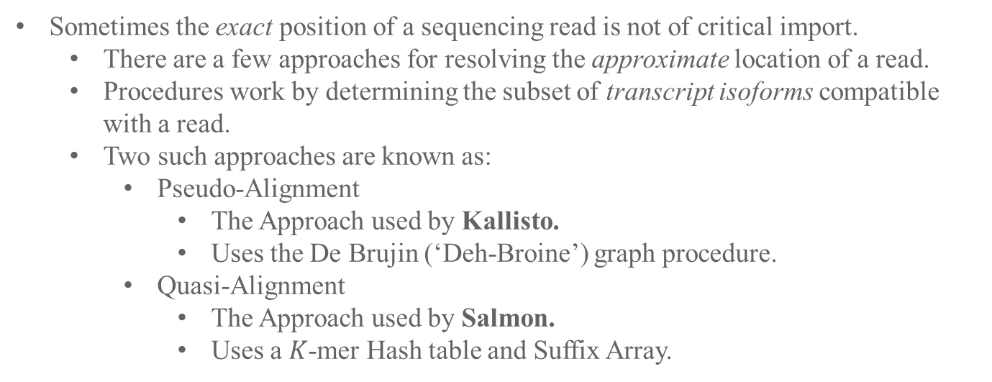
Pseudo/Quasi Alignment in RNA Experiments
Typical ‘DNA-Seq Like’ Experiment
Reads
Sometimes the exact position of a sequencing read is not of critical import.
There are a few approaches for resolving the approximate location of a read.
Procedures work by determining the subset of transcript isoforms compatible with a read.
Two such approaches are known as:
Pseudo-Alignment
The Approach used by Kallisto.
Uses the De Brujin (‘Deh-Broine’) graph procedure.
Quasi-Alignment
The Approach used by Salmon.
Uses a $K$-mer Hash table and Suffix Array.
Reference
Typical ‘RNA-Seq Like’
Experiment
Reads mapped to compatible isoforms in Transcriptome
T1
T2
Expectation
Maximization
T1
T2
T3
T4
3
2
4
1
||||
||||
|||| |
T3
T4
||||
Recall that in most typical sequencing experiments we are dealing with a large collection of shorter subsequences called reads, which we attempt to map to a larger sequence known as the reference.
Resources – Kallisto (Pseudo-alignment)
https://tinyheero.github.io/2015/09/02/pseudoalignments-kallisto.html (Higher Level Overview pseudo alignment)
https://www.youtube.com/watch?v=f-ecmECK7lw (Video Describing how To Build The De Brujin graph)
https://www.nature.com/articles/nbt.2023 (Nature Primer on Using De Brujin Graphs for Genomic Alignments).
Resources – Salmon (Quasi-alignment)
https://hbctraining.github.io/Intro-to-rnaseq-hpc-salmon-flipped/lessons/08_quasi_alignment_salmon.html (Higher Level Overview Quasi-Alignment)
https://academic.oup.com/bioinformatics/article/32/12/i192/2288985?login=true (RapMap Paper and Description).

Slide 7
Part 2: Expectation Maximization & Gene Transcript Quantification

